Slide 1
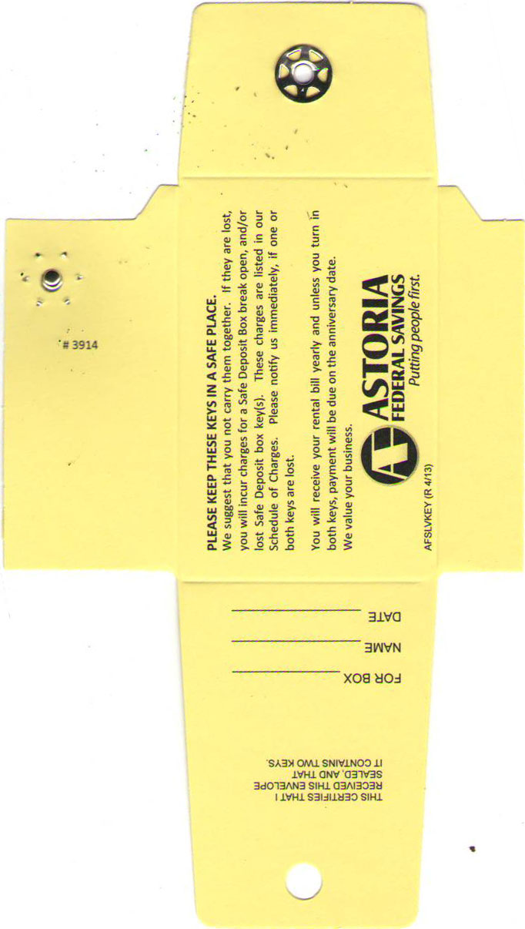
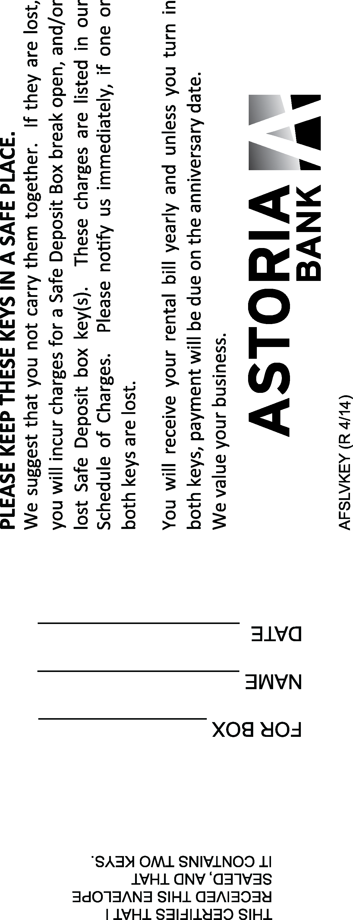
# 3914
# 3914
Click to delete before Printing plate!
Click to delete before Printing plate!

