Slide 1
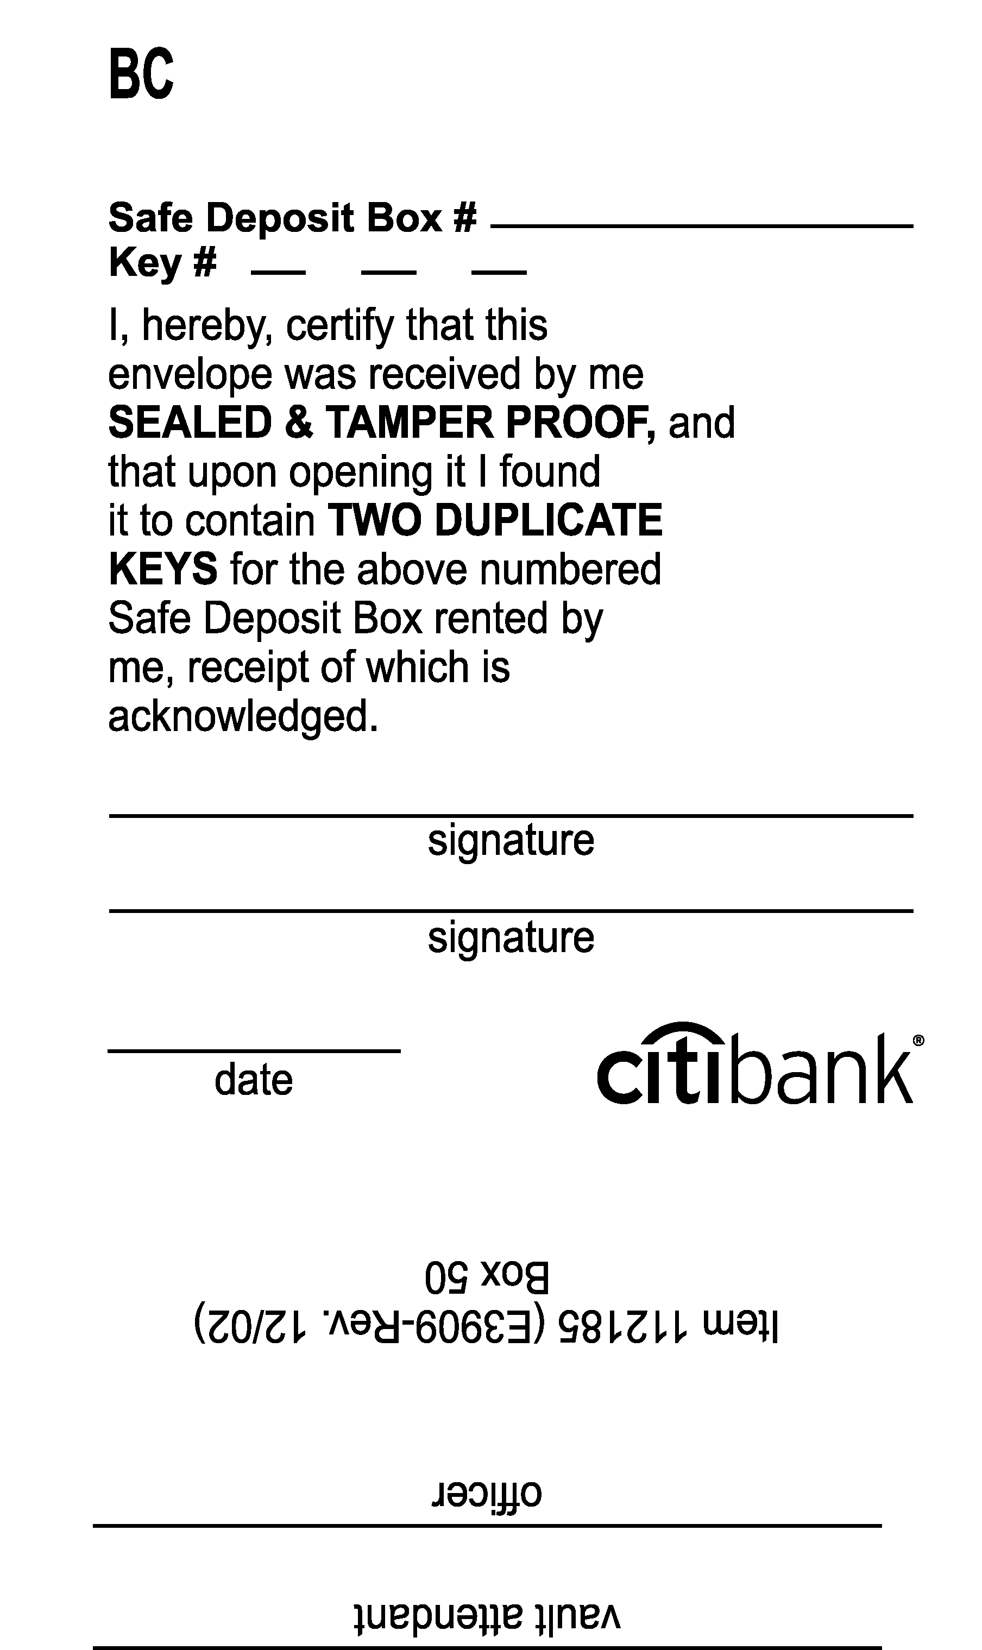
# 3603
Click to delete before Printing plate!

