Slide 1
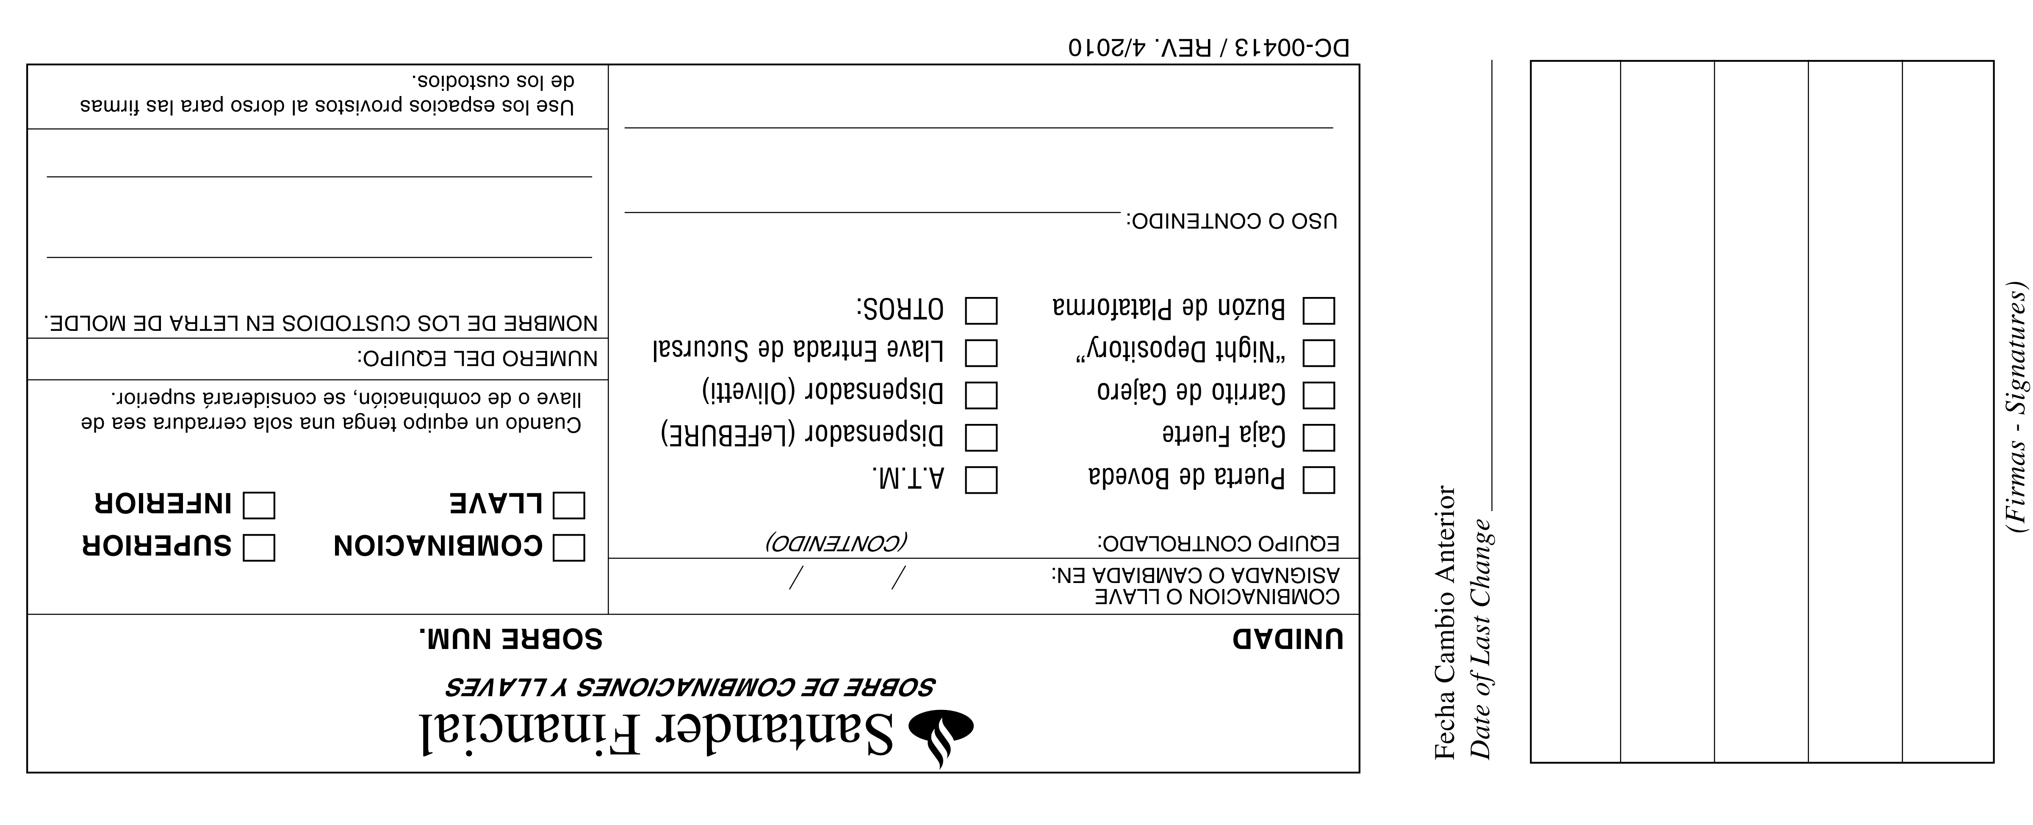
WISE SYSTEMS – TEL. (787) 653-3200 – (787) 653-3201
# 3451

