Slide 1
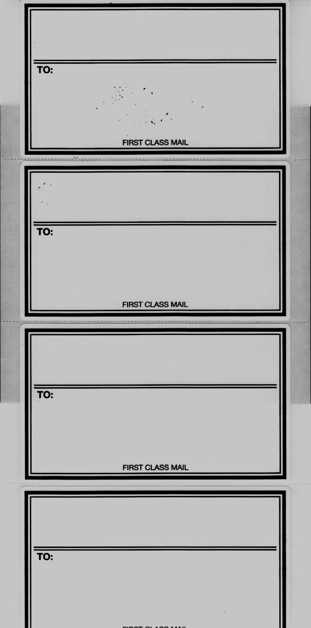
Day Meeker Lamping Schlegel & Salazar
Attorneys at Law
112 SOUTH AVENUE B – P.O. BOX 929
WASHINGTON, IOWA 52353-0929
Day Meeker Lamping Schlegel & Salazar
Attorneys at Law
112 SOUTH AVENUE B – P.O. BOX 929
WASHINGTON, IOWA 52353-0929
Day Meeker Lamping Schlegel & Salazar
Attorneys at Law
112 SOUTH AVENUE B – P.O. BOX 929
WASHINGTON, IOWA 52353-0929
Day Meeker Lamping Schlegel & Salazar
Attorneys at Law
112 SOUTH AVENUE B – P.O. BOX 929
WASHINGTON, IOWA 52353-0929

