Slide 1
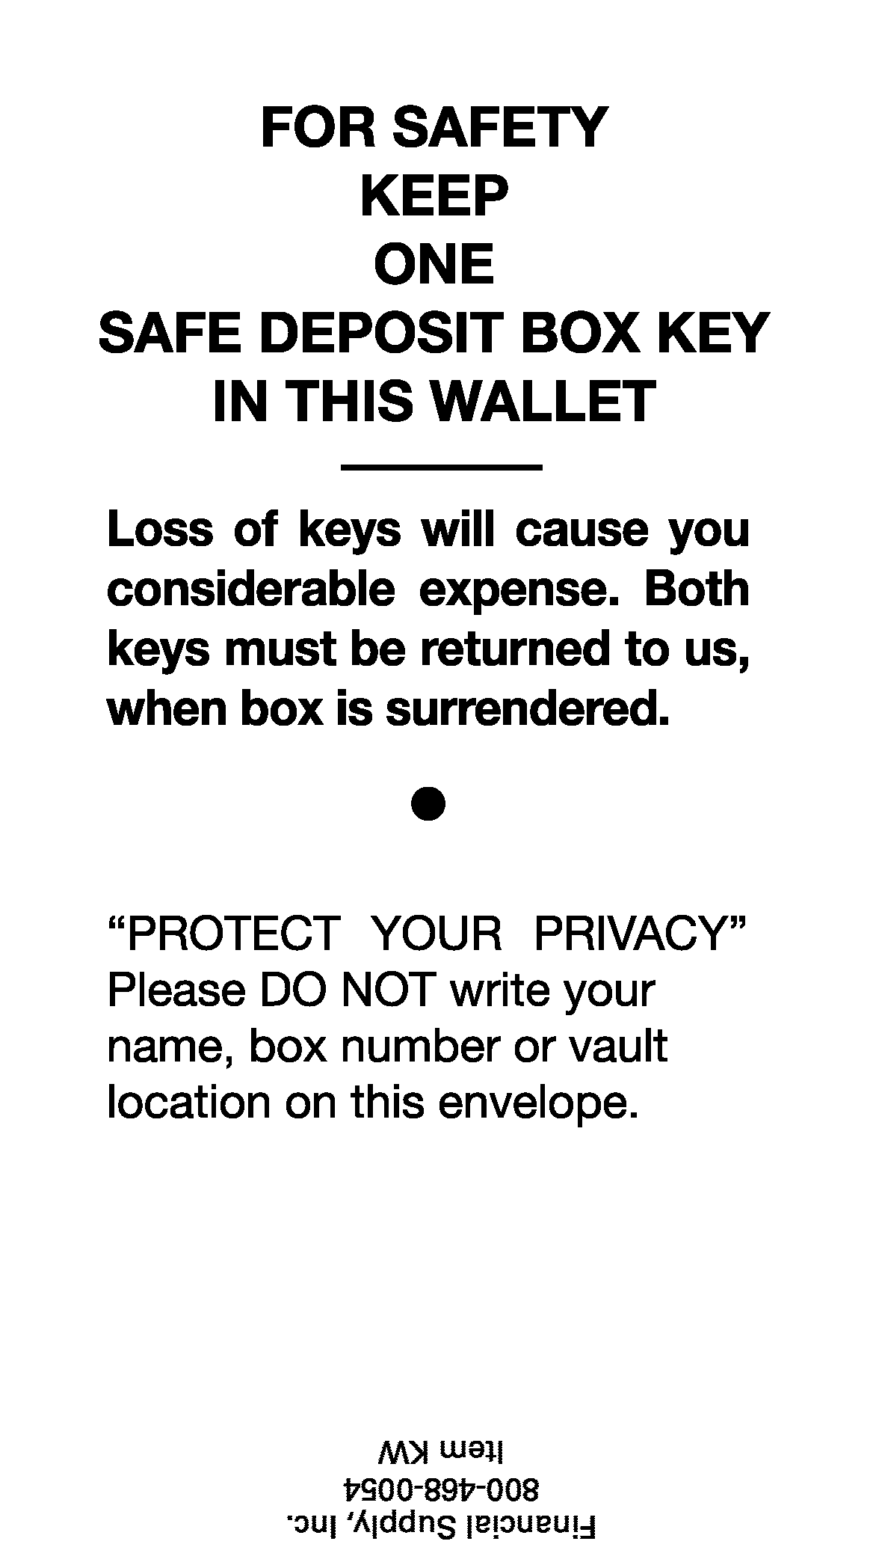
# 2273
# 2273
American Solutions for Business
800-468-0054
Item KW
American Solutions for Business
800-468-0054
Item KW
# 2273
# 2273
# 372
# 372
American Solutions for Business
800-468-0054
Item KW
American Solutions for Business
800-468-0054
Item KW

