Slide 1
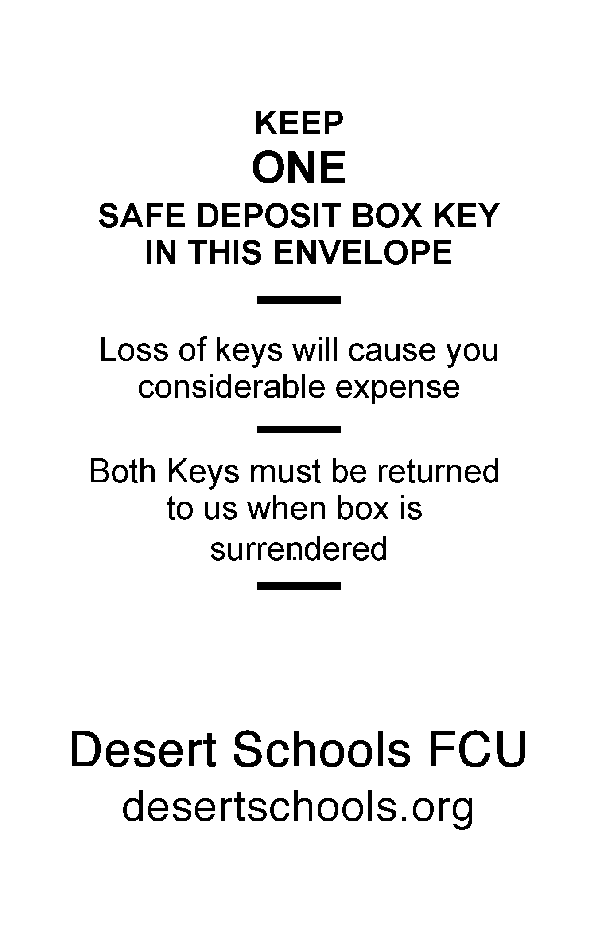
Click to delete before Printing plate!
Click to delete before Printing plate!
# 2026
# 2026

