Slide 1
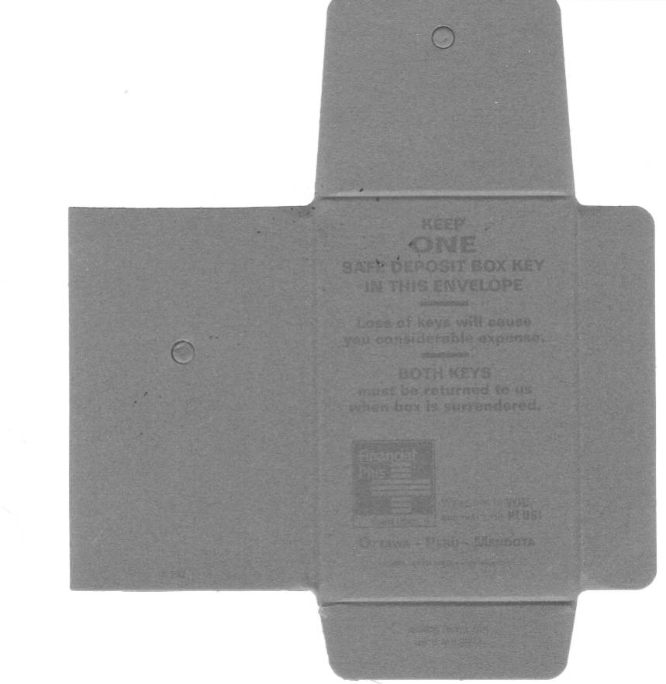
Click to delete before Printing plate!
KEEP
ONE
SAFE DEPOSIT BOX KEY
IN THIS ENVELOPE
Loss of keys will cause you
considerable expense.
Both Keys must be returned to us when box is surrendered.
# 1627
Form # 450-140
KEEP
ONE
SAFE DEPOSIT BOX KEY
IN THIS ENVELOPE
Loss of keys will cause you
considerable expense.
Both Keys must be returned to us when box is surrendered.
# 1627
Form # 450-140

