Slide 1
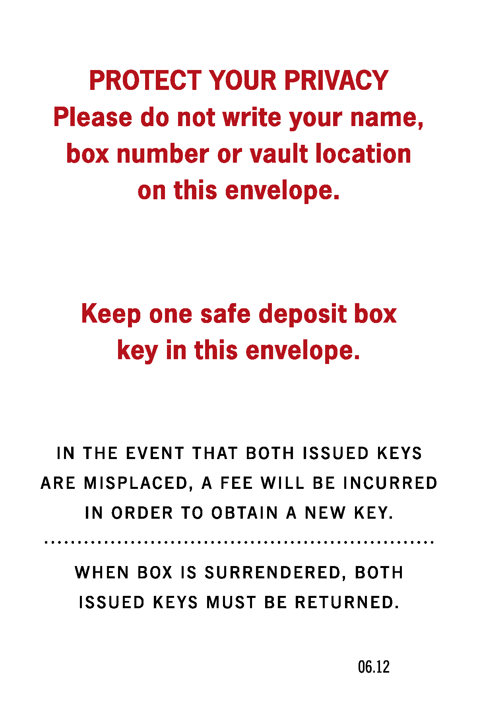
Black & Red Ink
Black & Red Ink
# 983
# 983
Black & Red Ink
Black & Red Ink
# 983
# 983

