Slide 1
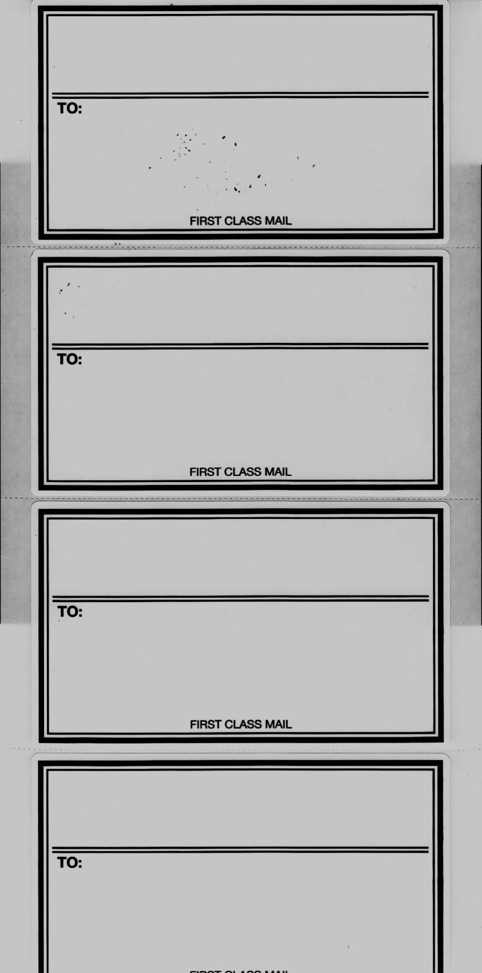
KOLB ROELLGEN & KIRCHOFF LLP
P.O. BOX 215
VINCENNES, IN 47591
To:
KOLB ROELLGEN & KIRCHOFF LLP
P.O. BOX 215
VINCENNES, IN 47591
To:
KOLB ROELLGEN & KIRCHOFF LLP
P.O. BOX 215
VINCENNES, IN 47591
To:
KOLB ROELLGEN & KIRCHOFF LLP
P.O. BOX 215
VINCENNES, IN 47591
To:

