Slide 1
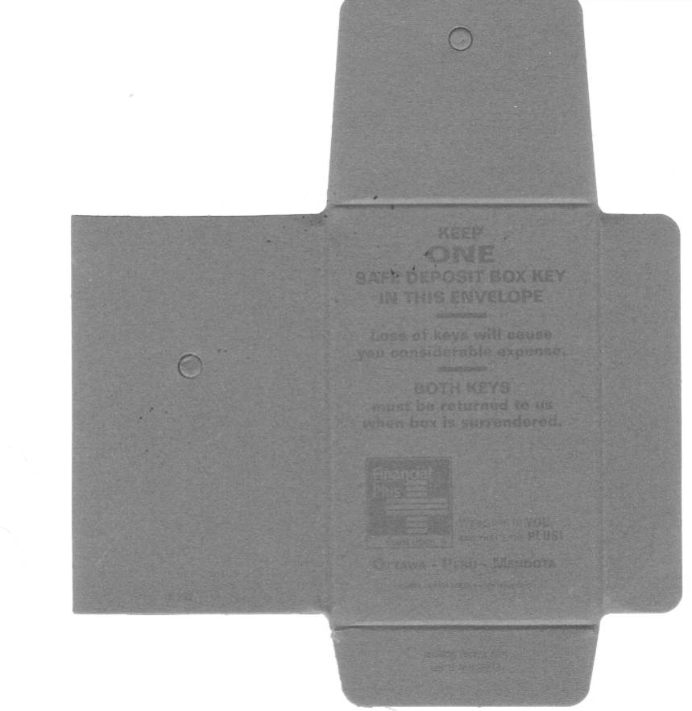
Click to delete before Printing plate!
KEEP ONE
SAFE DEPOSIT BOX KEY
IN THIS ENVELOPE
KEEP ONE
SAFE DEPOSIT BOX KEY
IN THIS ENVELOPE
Loss of keys will cause you
considerable expense.
Loss of keys will cause you
considerable expense.
Both Keys must be returned to us when box is surrendered.
Both Keys must be returned to us when box is surrendered.
# 829
# 829
E. Greene & Co.
Fairfield, NJ 07007
Form KW-W-SP Key Wallet Special
877-838-5250
NC 40346 SDP (REV 6-99)
E. Greene & Co.
Fairfield, NJ 07007
Form KW-W-SP Key Wallet Special
877-838-5250
NC 40346 SDP (REV 6-99)

