Slide 1
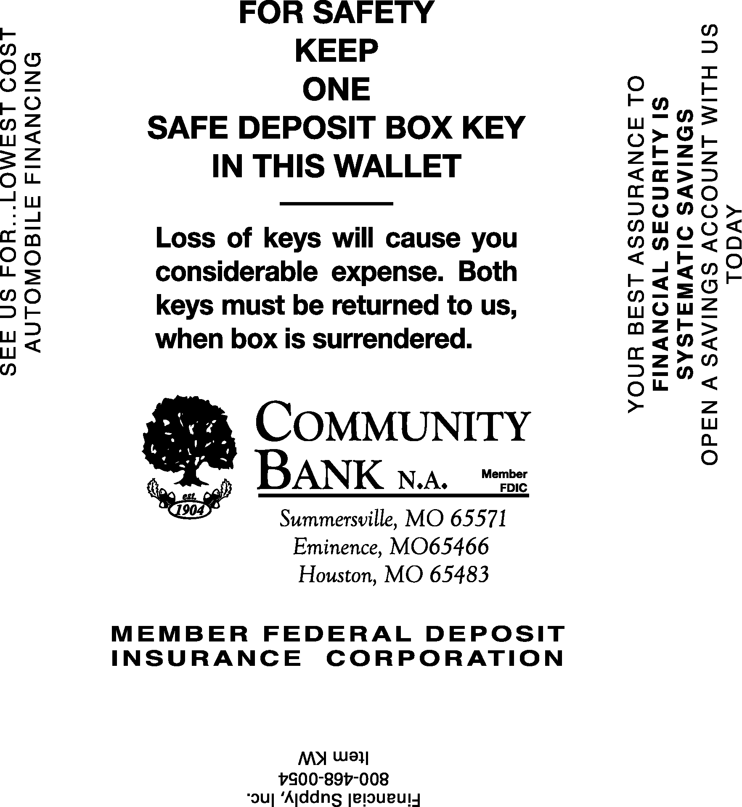
# 716
# 716
# 716
# 716

