Slide 1
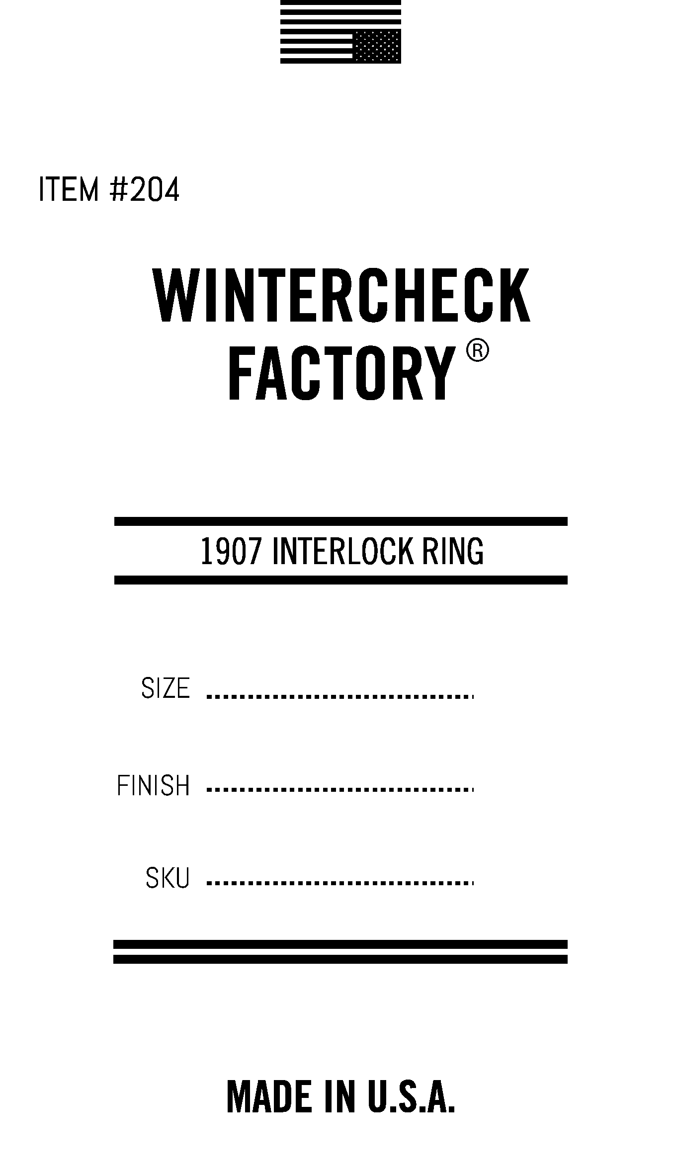
Click to delete before Printing plate!
Click to delete before Printing plate!

