Slide 1
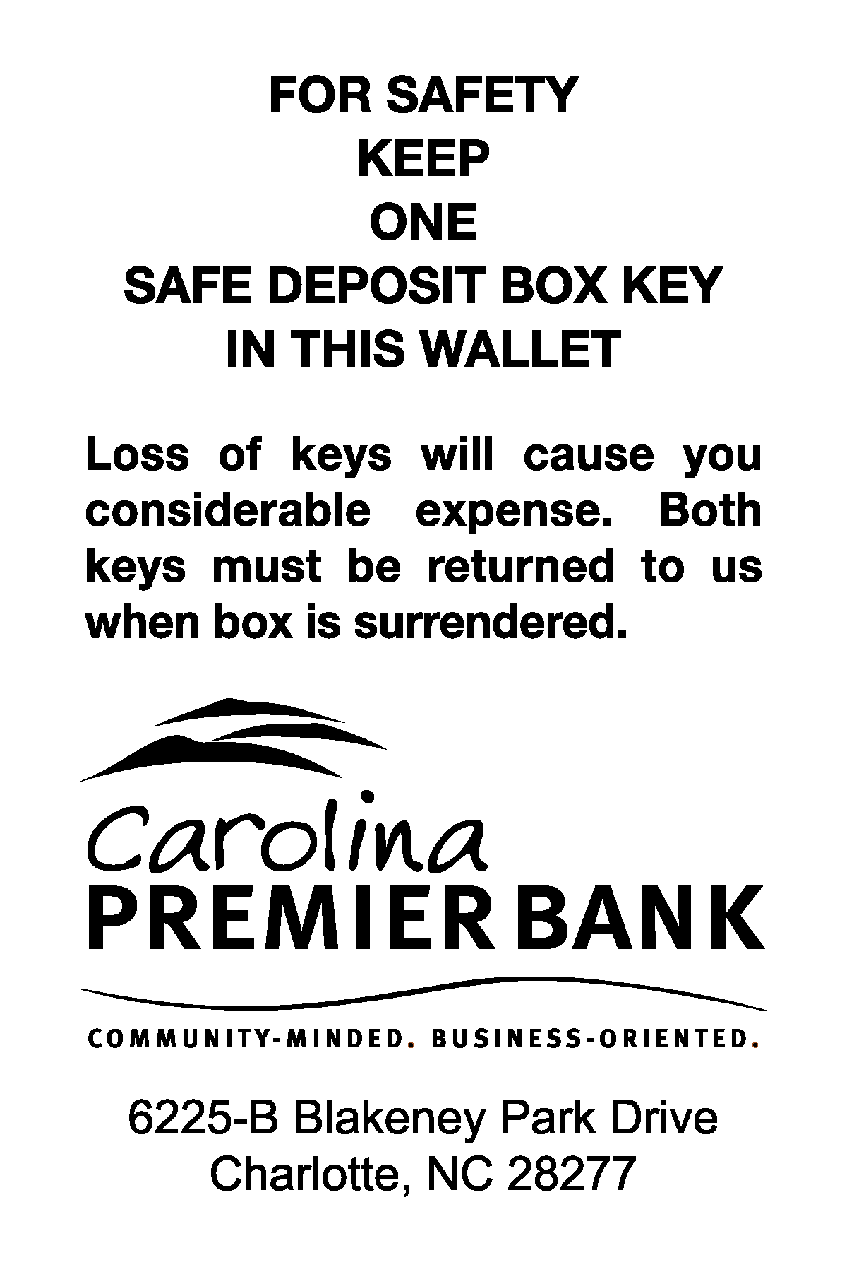
# 522
# 522
American Solutions for Business
KW-B Key Wallet
American Solutions for Business
KW-B Key Wallet
# 522
# 522
American Solutions for Business
KW-B Key Wallet
American Solutions for Business
KW-B Key Wallet

