Slide 1
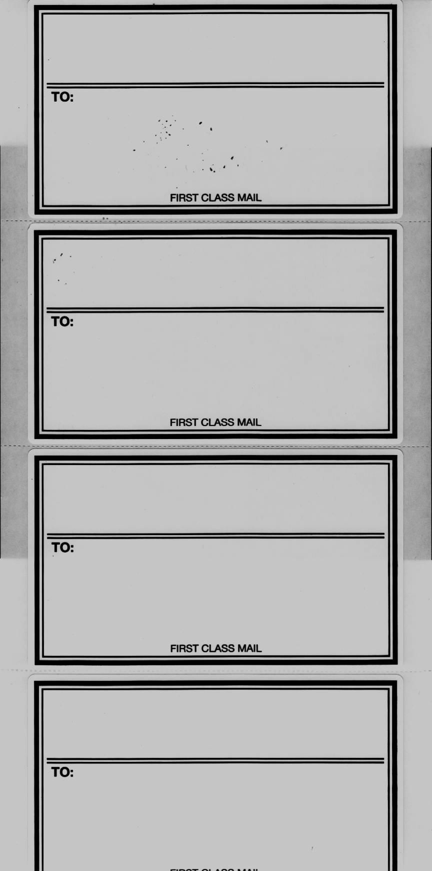
KRIZ, JENKINS, PREWITT & JONES
A PROFESSIONAL SERVICE CORPORATION
BB&T PLAZA
200 WEST VINE STREET
SUITE 710
LEXINGTON, KENTUCKY 40507-1620
TO:
FIRST CLASS MAIL
KRIZ, JENKINS, PREWITT & JONES
A PROFESSIONAL SERVICE CORPORATION
BB&T PLAZA
200 WEST VINE STREET
SUITE 710
LEXINGTON, KENTUCKY 40507-1620
TO:
FIRST CLASS MAIL
KRIZ, JENKINS, PREWITT & JONES
A PROFESSIONAL SERVICE CORPORATION
BB&T PLAZA
200 WEST VINE STREET
SUITE 710
LEXINGTON, KENTUCKY 40507-1620
TO:
FIRST CLASS MAIL
KRIZ, JENKINS, PREWITT & JONES
A PROFESSIONAL SERVICE CORPORATION
BB&T PLAZA
200 WEST VINE STREET
SUITE 710
LEXINGTON, KENTUCKY 40507-1620
TO:
FIRST CLASS MAIL

